Slide 1


ADMIS Lab
先进数据与机器智能系统实验室
Database Design and E-R Model
Chapter 6
Yichao Zhang
Email: yichaozhang@tongji.edu.cn
Department of Computer Science and Technology
Tongji University

Slide 2
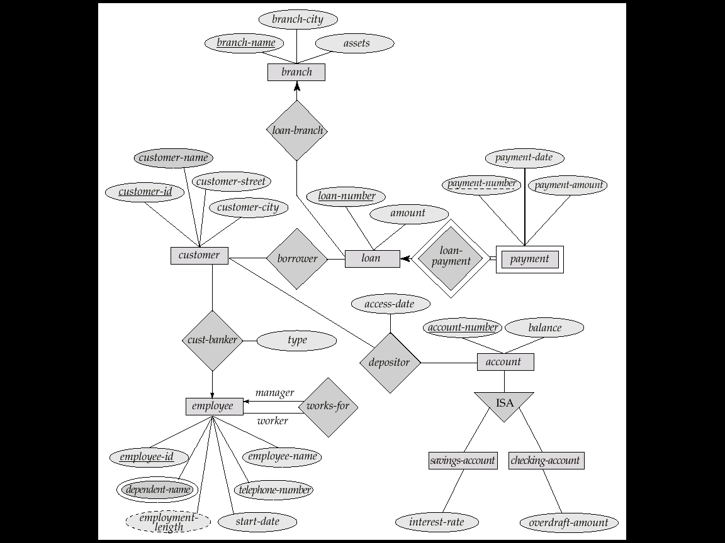
E-R Diagram & Relation Schema
branch = (branch_name, branch_city, assets)
customer = (customer_id, customer_name, customer_street, customer_city)
loan = (loan_number, amount)
account = (account_number, balance)
employee = (employee_id, employee_name, telephone_number, start_date)
dependent_name = (employee_id, dname) (derived from a multivalued attribute)
account_branch = (account_number, branch_name)
loan_branch = (loan_number, branch_name)
borrower = (customer_id, loan_number)
depositor = (customer_id, account_number, access_date)
cust_banker = (customer_id, employee_id, type)
works_for = (worker_employee_id, manager_employee_id)
payment =(loan_number,payment_number,payment_date,payment_amount)
savings_account = (account_number, interest_rate)
checking_account = (account_number, overdraft_amount)
E-R图
关系模式

Slide 3
Outline
Overview of the Design Process
Entity-Relationship Model (实体联系模型)
Constraints
Entity-Relationship Diagrams (实体联系图)
Reduction to Relation Schemas
Summary

Slide 4
开发数据库应用的主要任务
用户需求
设计数据库模式
设计访问和更新数据的程序
设计控制数据访问的安全模式
关系（表）
关系的属性
约束

Slide 5
Data Abstraction (数据抽象)
Real Word
Abstraction
Real world Conceptual model
Database Designers
Information world
Conceptual model
Conceptual model Logical model
Database Designers
Data model supported
by DBMS
Machine world
Logical model Physical model
DBMS

Slide 6
Database Design (数据库设计)
Conceptual design(概念设计)
  Map a real world organization to a conceptual model
Logical design(逻辑设计)
  Transform the conceptual model to a logical model
Physical design(物理设计)
  Instantiate the logical model to physical organization and storage
Notes:
Instantiating：实例化

Slide 7
Database Design (Cont.)
Understand the real-world domain being modeled
Specify it using a database design model
  Design models are especially convenient for schema design, but are not necessarily implemented by DBMS
    Entity-Relationship (E-R) model
    Object Definition Language (ODL)
Translate specification （规范） to the data model of DBMS
  Relational, XML, object-oriented, etc.
Create the DBMS schema

Slide 8
Outline
Overview of the Design Process
Entity-Relationship Model (实体联系模型)
Constraints
Entity-Relationship Diagrams (实体联系图)
Reduction to Relation Schemas
Summary

Slide 9
E-R Diagram for a Banking Enterprise

Slide 10
大学E-R图

Slide 11
Database Conceptual Design
Conceptual design (ER Model is used at this stage)
  What are the entities and relationships?
  What information about these entities and relationships should be stored in the database?
  What are the integrity constraints or business rules that should hold?
  A database ‘schema’ in the ER Model can be represented pictorially using ER diagram
  An ER diagram can be then mapped into a relational schema
Notes:
Pictorially：绘画般地

Slide 12
ER Model: A General View
A “watered-down” object-oriented design model
Primarily a design model—not implemented by any major DBMS
Three concepts
  Entity set
  Attribute
  Relationship set
Notes:
“watered-down”：淡化了的

Slide 13

Peter Pin-Shan Chen（陈品山）
Dr. Peter P. Chen is the originator of the Entity-Relationship Model (E-R Model), and the founder of ER international conference
The E-R model serves as the foundation of many system analysis and design methodologies, computer-aided software engineering (CASE) tools, and repository systems
Peter Chen, The Entity-Relationship Model--Toward a Unified View of Data
ACM Transactions on Database Systems, Vol. 1, No. 1, March 1976, Pages 9 - 36

Slide 14
Entity Sets（实体集）
A database can be modeled as
  a collection of entities
  relationship among entities
An entity is an object that exists and is distinguishable from other objects
  E.g., specific person, company, event, university
Entities have attributes
  E.g., people have names and addresses
An entity set is a set of entities of the same type that share the same properties
  E.g., the set of all persons, companies, trees, holidays
Notes:
An entity set（一个实体或关系） is a set of entities of the same type that share the same properties,
or attributes. The set of all people who are instructors at a given university, for
example, can be defined as the entity set instructor. Similarly, the entity set student
might represent the set of all students in the university.
extension of the entity set to refer to the actual collection of entities belonging to
the entity set. Thus, the set of actual instructors in the university forms the extension of the entity set instructor. The above distinction is similar to the difference
between a relation and a relation instance

Slide 15
Entity Sets

Slide 16
Attributes（属性）
An entity contains a set of attributes, and these attributes are possessed by all members of an entity set
  Instructor: ID, name, salary
  Student: ID, name, tot_cred
Domain (域) – the set of permitted values for each attribute
Attribute types
  Simple and composite attributes (复合属性)
  Single-valued and multi-valued attributes
  Derived attributes
Notes:
a composite attribute may appear as a hierarchy .
upper and lower bounds may be placed on the number
of values in a multivalued attribute. For example, a university may limit the
number of phone numbers recorded for a single instructor to two.
The value of a derived attribute is not stored but is computed when required.

Slide 17
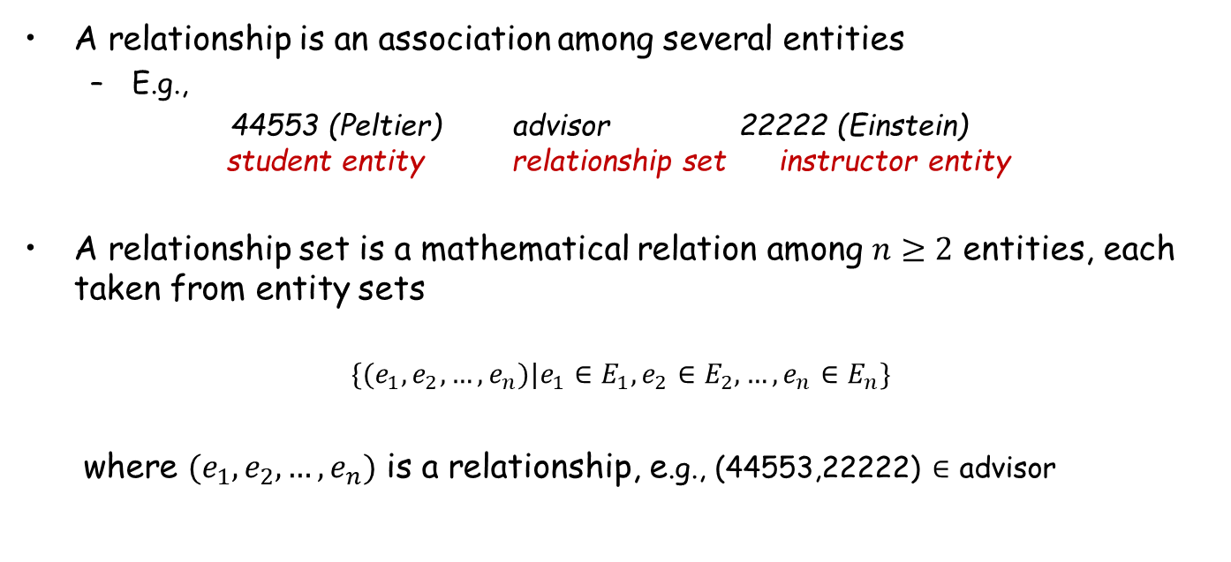
Relationship Sets (联系集)
A relationship is an association among several entities
  E.g.,
  44553 (Peltier) advisor 22222 (Einstein)
  student entity relationship set instructor entity
A relationship set is a mathematical relation among $n≥2$ entities, each taken from entity sets
$$\{(e_{1},e_{2},…,e_{n})|e_{1}∈E_{1},e_{2}∈E_{2},…,e_{n}∈E_{n}\}$$
where $(e_{1},e_{2},…,e_{n})$ is a relationship, e.g., (44553,22222) $∈$ advisor

Slide 18
Relationship Set advisor

Slide 19
Relationship Sets (Cont.)
A relationship set may also contain some attributes
For instance, the advisor relationship set between entity sets instructor and student may have the attribute date which tracks when the student started being associated with the advisor

Slide 20
Degree (度/阶) of a Relationship Set
The number of entity sets that participate in a relationship set
  Relationship sets that involve two entity sets are binary (二元的)
  Relationship sets may involve more than two entity sets, which is rare
    E.g., E-R diagram with a ternary relationship

Slide 21
Outline
Overview of the Design Process
Entity-Relationship Model (实体联系模型)
Constraints
Entity-Relationship Diagrams (实体联系图)
Reduction to Relation Schemas
Summary

Slide 22
Mapping Cardinalities (映射基数)
Express the number of entities to which another entity can be associated via a relationship set
For a binary relationship set, the mapping cardinality is one of the following types
  One to one (1对1): An entity in A is associated with at most one entity in B, and an entity in B is associated with at most one entity in A
  One to many (1对多): An entity in A is associated with any number (zero or more) of entities in B. An entity in B, however, can be associated with at most one entity in A
  Many to one (多对1): An entity in A is associated with at most one entity in B. An entity in B, however, can be associated with any number (zero or more) of entities in A
  Many to many (多对多): An entity in A is associated with any number (zero or more) of entities in B, and an entity in B is associated with any number (zero or more) of entities in A

Slide 23
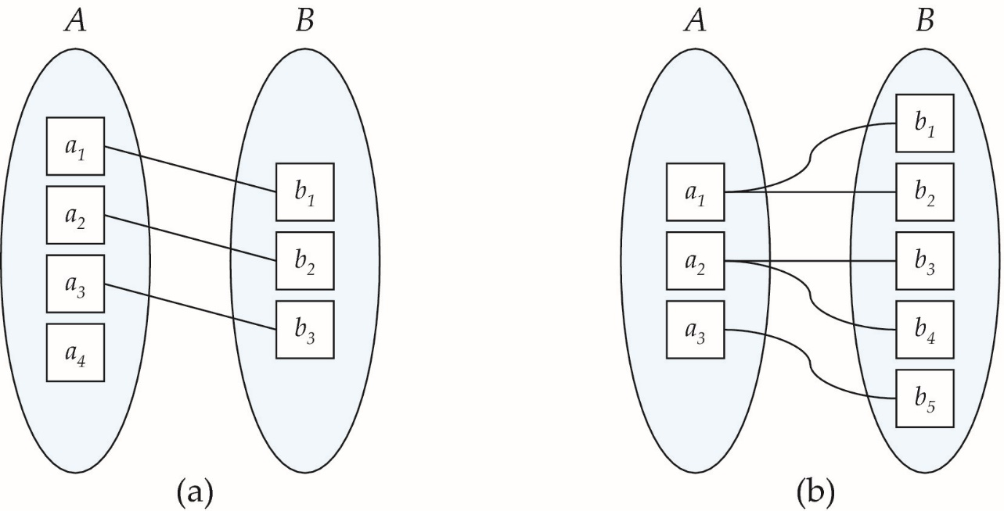
Mapping Cardinalities (Cont.)
One to one
One to many
Note: Some elements in A and B may not be mapped to any elements in the other set

Slide 24
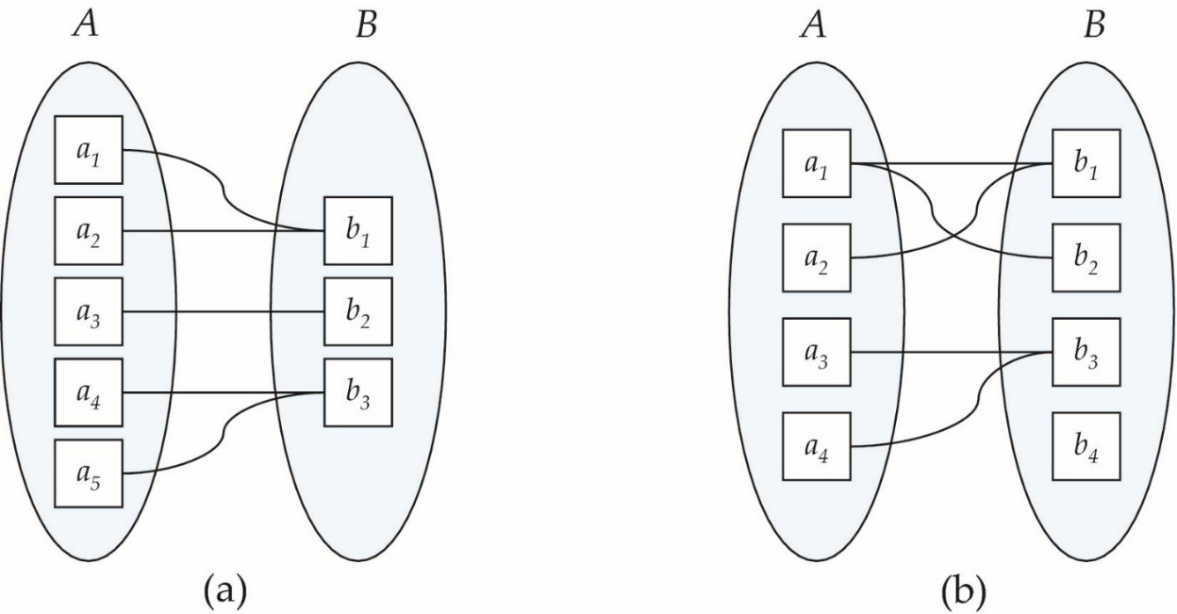
Mapping Cardinalities (Cont.)
Many to one
Many to many
Note: Some elements in A and B may not be mapped to any elements in the other set

Slide 25
Participation Constraints (参与约束)
Total participation
  Every entity in the entity set participates in at least one relationship in the relationship set
  E.g., 每个student实体通过advisor联系同至少一名教师关联，student在联系集advisor中是全部参与
Partial participation
  Some entities may not participate in any relationship in the relationship set
  E.g., 有的instructor可能不指导学生，所以instructor在联系集advisor中是部分参与

Slide 26
Outline
Overview of the Design Process
Entity-Relationship Model (实体联系模型)
Constraints
Entity-Relationship Diagrams (实体联系图)
Reduction to Relation Schemas
Summary

Slide 27
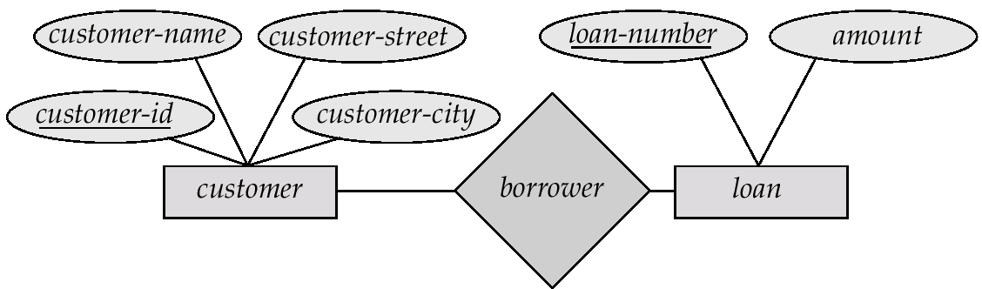
Entity-Relationship Diagrams
Rectangles represent entity sets
Diamonds represent relationship sets.
Lines link attributes to entity sets and entity sets to relationship sets.
Ellipses represent attributes
  Double ellipses represent multi-valued attributes
  Dashed ellipses denote derived attributes
Underline indicates primary key attributes
Entity sets can be represented graphically as follows:
  Rectangles represent entity sets.
  Attributes listed inside entity rectangle
  Underline indicates primary key attributes
  Diamonds represent relationship sets
Notes:
两种表述方式：左侧是Chen方法，右边是Crow’s foot方法

Slide 28
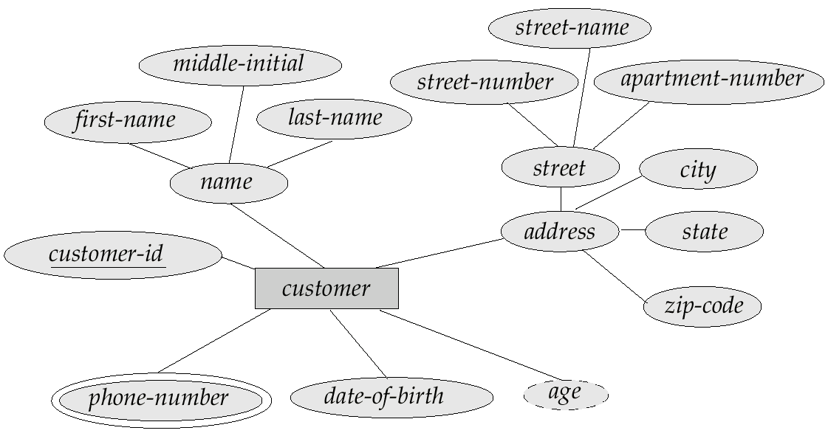
E-R Diagram
E-R Diagram with composite, multivalued, and derived attributes
composite attribute
derived attribute
multi-valued attribute

Slide 29
Relationship Sets with Attributes

Slide 30
Roles (角色)
Entity sets of a relationship need not be distinct
  Each occurrence of an entity set plays a “role” in the relationship
  The labels “course_id” and “prereq_id” are called roles

Slide 31
Cardinality Constraints
We express cardinality constraints by drawing either a directed line (→), signifying “one,” or an undirected line (—), signifying “many,” between the relationship set and the entity set.
One-to-one relationship
  A student is associated with at most one instructor via the relationship advisor, and vice versa
  A student is associated with at most one department via stud_dept

Slide 32
One-To-Many Relationship
One-to-many relationship
  an instructor is associated with several (including 0) students via advisor
  a student is associated with at most one instructor via advisor

Slide 33
Many-To-One Relationships
Many-to-one relationship
  an instructor is associated with at most one student via advisor
  a student is associated with several (including 0) instructors via advisor

Slide 34
Many-To-Many Relationship
Many-to-many relationship
  An instructor is associated with several (possibly 0) students via advisor
  A student is associated with several (possibly 0) instructors via advisor

Slide 35
Alternative Notation for Cardinality Limits
A line may have an associated minimum and maximum cardinality, shown in the form l…h, where l is the minimum and h the maximum cardinality
  A minimum value of 1 indicates total participation
  A maximum value of 1 indicates that the entity participates in at most one relationship
  A maximum value of * indicates no limit
Example
  Instructor can advise 0 or more students. A student must have 1 advisor and cannot have multiple advisors

Slide 36
Keys (键/码)
A superkey (超键) of an entity set is a set of one or more attributes whose values uniquely determine each entity
A candidate key (候选键) of an entity set is a minimal superkey
  student_id is a candidate key of student
  account_number is a candidate key of account
Although several candidate keys may exist, one of the candidate keys is selected to be the primary key (主键)

Slide 37
Keys for Relationship Sets
The combination of primary keys of the participating entity sets forms a superkey of a relationship set
  (customer_id, account_number) is the super key of depositor
Must consider the mapping cardinality of the relationship set when deciding the candidate keys
Need to consider semantics of relationship set in selecting the primary key in case of more than one candidate key
Notes:
Suppose that the relationship set is many-to-many. Then the primary
key of advisor consists of the union of the primary keys of instructor and student. If
the relationship is many-to-one from student to instructor—that is, each student
can have at most one advisor—then the primary key of advisor is simply the
primary key of student. However, if an instructor can advise only one student—
that is, if the advisor relationship is many-to-one from instructor to student—then
the primary key of advisor is simply the primary key of instructor. For one-to-one
relationships either candidate key can be used as the primary key.

Slide 38
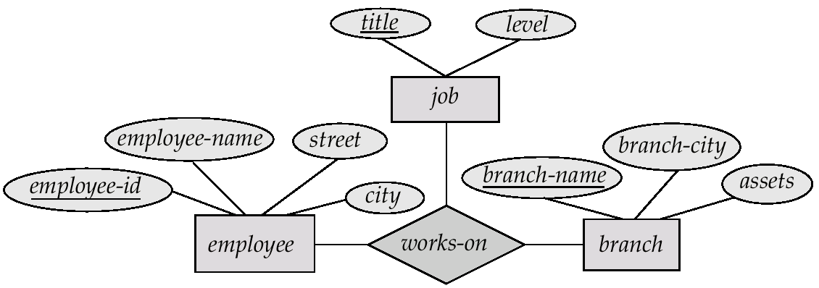
E-R Diagram with a Ternary Relationship

Slide 39
Binary vs. Non-Binary Relationships
Some relationships that appear to be non-binary may be better represented using binary relationships
  E.g. A ternary relationship parents, relating a child to his/her father and mother, can be replaced by two binary relationships, father and mother
    Using two binary relationships allows partial information (e.g., only mother being known)
  But there are some relationships that are naturally non-binary
    E.g. works-on, proj_guide

Slide 40
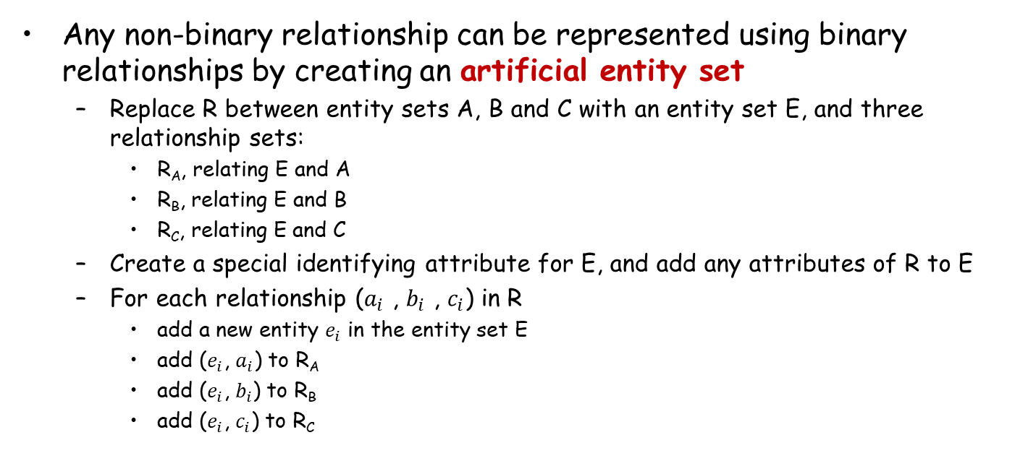
Converting Non-Binary Relationships
Any non-binary relationship can be represented using binary relationships by creating an artificial entity set
  Replace R between entity sets A, B and C with an entity set E, and three relationship sets:
    R_{A}, relating E and A
    R_{B}, relating E and B
    R_{C}, relating E and C
  Create a special identifying attribute for E, and add any attributes of R to E
  For each relationship ($a_{i}$ , $b_{i}$ , $c_{i}$) in R
    add a new entity $e_{i}$ in the entity set E
    add ($e_{i}$, $a_{i}$) to R_{A}
    add ($e_{i}$, $b_{i}$) to R_{B}
    add ($e_{i}$, $c_{i}$) to R_{C}

Slide 41
Converting Non-Binary Relationships (Cont.)
Translate constraints
  Translating all constraints may not be possible
  There may be instances in the translated schema that cannot correspond to any instance of R
  We can avoid creating an identifying attribute by making E a weak entity set (described shortly) identified by the three relationship sets

Slide 42
Weak Entity Sets（弱实体集）
Entity set section
  uniquely identified by a course_id, semester, year, and sec_id.
  related to course entities
Relationship set sec_course between entity sets section and course
  the information in sec_course is redundant, since section already has an attribute course_id, which identifies the course with which the section is related
  Solution A: Get rid of the relationship sec_course. However, by doing so the relationship between section and course becomes implicit in an attribute, which is not desirable
  Solution B: Not store the attribute course_id in the section entity and only store the remaining attributes section_id, year, and semester. However, the entity set section then does not have enough attributes to identify a particular section entity uniquely
Way out
  Treat sec_course as a special relationship that provides extra information, the course_id, required to identify section entities uniquely
  A weak entity set is one whose existence is dependent on another entity, called its identifying entity (标识性实体)
  Instead of associating a primary key with a weak entity, we use the identifying entity, along with extra attributes called discriminator (分辨符) to uniquely identify a weak entity

Slide 43
Weak Entity Sets（Cont.）
Strong entity set
  An entity set that is not a weak entity set is termed a strong entity set.
Weak entity set & identifying entity
  Every weak entity must be associated with an identifying entity. The weak entity set is said to be existence dependent on the identifying entity set (标识性实体集).
  The identifying entity set is said to own the weak entity set that it identifies.
  The relationship associating the weak entity set with the identifying entity set is called the identifying relationship (标识性关系)

Slide 44
Weak Entity Sets (Cont.)
In E-R diagrams, a weak entity set is depicted via a double rectangle
The discriminator of a weak entity set is underlined with a dashed line
The relationship set connecting the weak entity set to the identifying strong entity set is depicted by a double diamond
Primary key for section – (course_id, sec_id, semester, year)
Notes:
The figure also illustrates the use of double lines to indicate total participation （完全参与）;
the participation of the (weak) entity set section in the relationship sec course is
total, meaning that every section must be related via sec_course to some course.
Finally, the arrow from sec_course to course indicates that each section is related to
a single course.
A weak entity set may be more appropriately modeled as an
attribute if it participates in only the identifying relationship, and if it has few
attributes. Conversely, a weak entity set representation more aptly （恰当地） models a
situation where the set participates in relationships other than the identifying
relationship, and where the weak entity set has several attributes.

Slide 45
Specialization（特化）
自上而下的设计过程
  Designate subgroupings within an entity set that are distinctive from other entities in the set
  These subgroupings become lower-level entity sets that have attributes or participate in relationships that do not apply to the higher-level entity set.
  Depicted by a triangle component labeled ISA, e.g., customer “is a” person
Attribute inheritance（属性继承）
  A lower-level entity set inherits all the attributes and relationship participation of the higher-level entity set to which it is linked
Notes:
Designate：指定

Slide 46
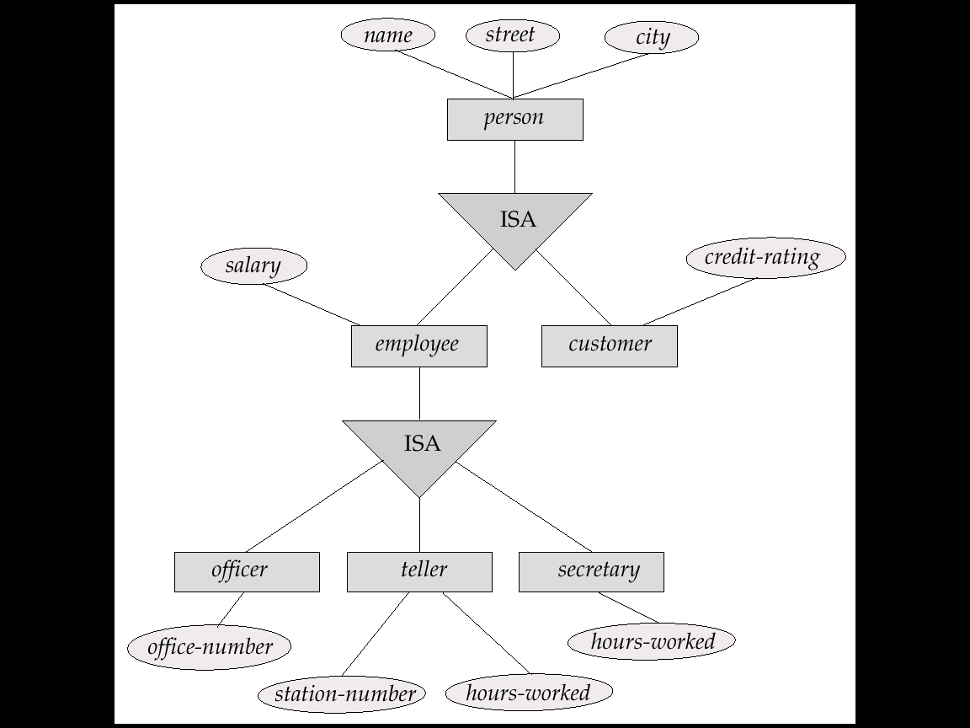
Example

Slide 47
Generalization（泛化）
自下而上的设计过程
  Combine a number of entity sets that share the same features into a higher-level entity set
特化与泛化
  Specialization and generalization are simple inversions of each other
  They are represented in the same way in an E-R diagram

Slide 48
Specialization & Generalization (Cont.)
Can have multiple specializations of an entity set based on different features.
  E.g., permanent-employee vs. temporary-employee, in addition to officer vs. secretary vs. teller
  Each particular employee would be
    a member of one of permanent-employee or temporary-employee,
    also a member of one of officer, secretary, or teller
The ISA relationship also referred to as superclass - subclass relationship
Notes:
The way we depict specialization in an E-R diagram depends on whether
an entity may belong to multiple specialized entity sets or if it must belong to at
most one specialized entity set. The former case (multiple sets permitted) is called
overlapping specialization, while the latter case (at most one permitted) is called
disjoint specialization.

Slide 49
Outline
Overview of the Design Process
Entity-Relationship Model (实体联系模型)
Constraints
Entity-Relationship Diagrams (实体联系图)
Reduction to Relation Schemas
Summary

Slide 50
Reduction to Relation Schemas
branch = (branch_name, branch_city, assets)
customer = (customer_id, customer_name, customer_street, customer_city)
loan = (loan_number, amount)
account = (account_number, balance)
employee = (employee_id, employee_name, telephone_number, start_date)
dependent_name = (employee_id, dname) (derived from a multivalued attribute)
account_branch = (account_number, branch_name)
loan_branch = (loan_number, branch_name)
borrower = (customer_id, loan_number)
depositor = (customer_id, account_number, access_date)
cust_banker = (customer_id, employee_id, type)
works_for = (worker_employee_id, manager_employee_id)
payment =(loan_number,payment_number,payment_date,payment_amount)
savings_account = (account_number, interest_rate)
checking_account = (account_number, overdraft_amount)
E-R图
关系模式

Slide 51
Reduction to Relational Schemas
Reduction of an E-R diagram to tables
  For each entity set and relationship set there is a unique table
  Each table has a number of columns
  Converting an E-R diagram to a table format is the basis for deriving a relational database design from an E-R diagram

Slide 52
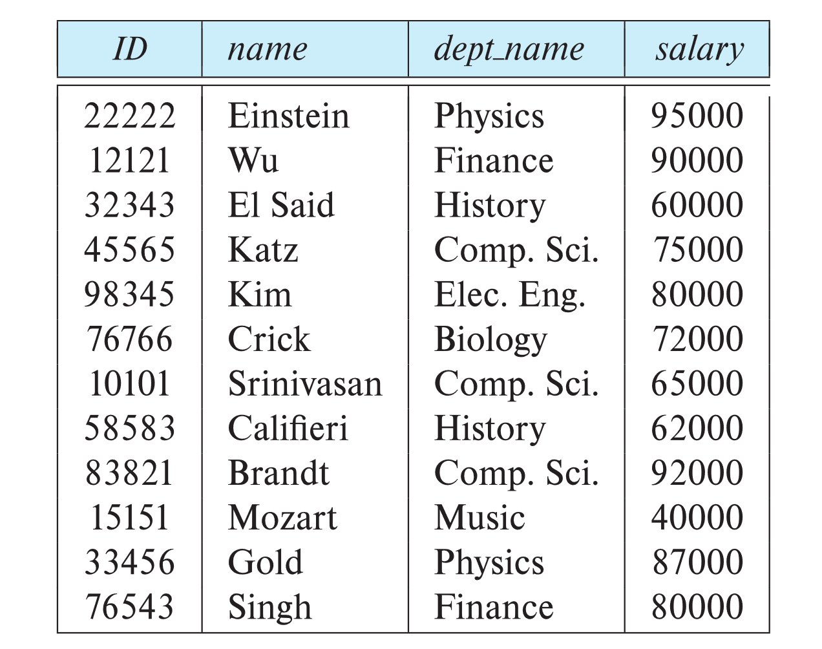
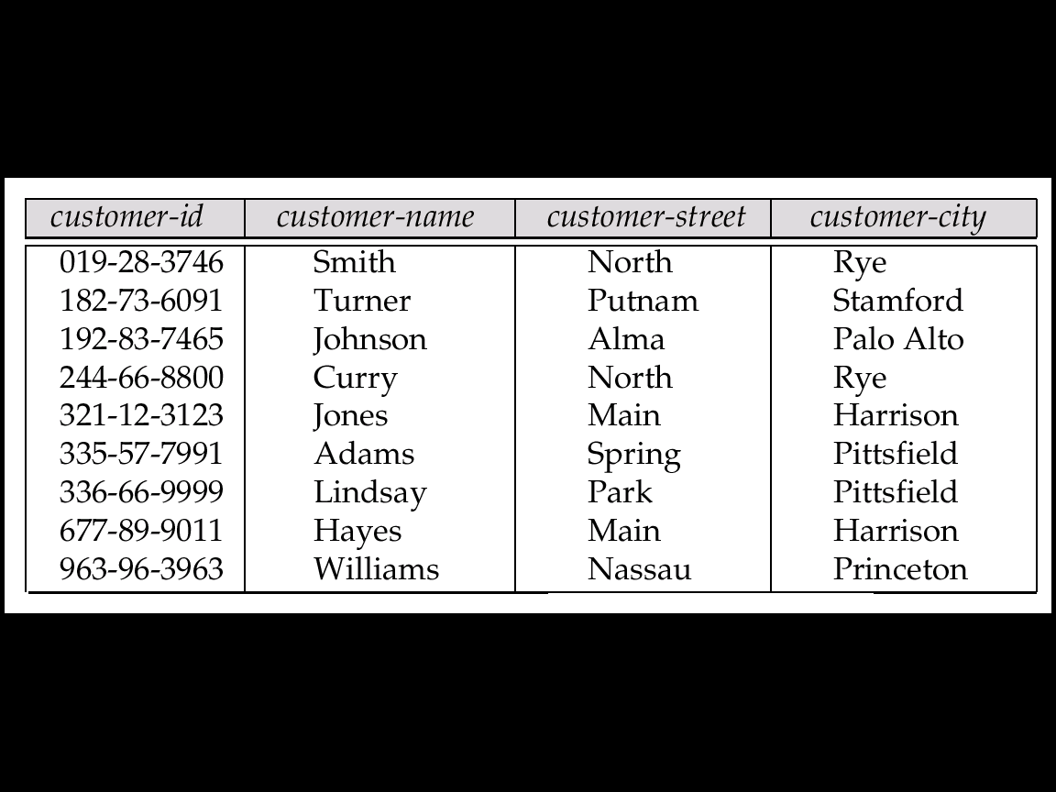
Representing Entity Sets as Tables
A strong entity set reduces to a table with the same attributes
Customer
Instructor

Slide 53
Composite and Multi-valued Attributes
Composite attributes are flattened out by creating a separate attribute for each component attribute
A multi-valued attribute M of an entity E is represented by a separate table EM
  Table EM has attributes corresponding to the primary key of E and an attribute corresponding to multivalued attribute M
  Each value of the multivalued attribute maps to a separate row of the table EM
Notes:
if we had an instructor with ID 22222, and phone numbers
555-1234 and 555-4321, the relation instructor phone would have two tuples (22222,
555-1234) and (22222, 555-4321).

Slide 54
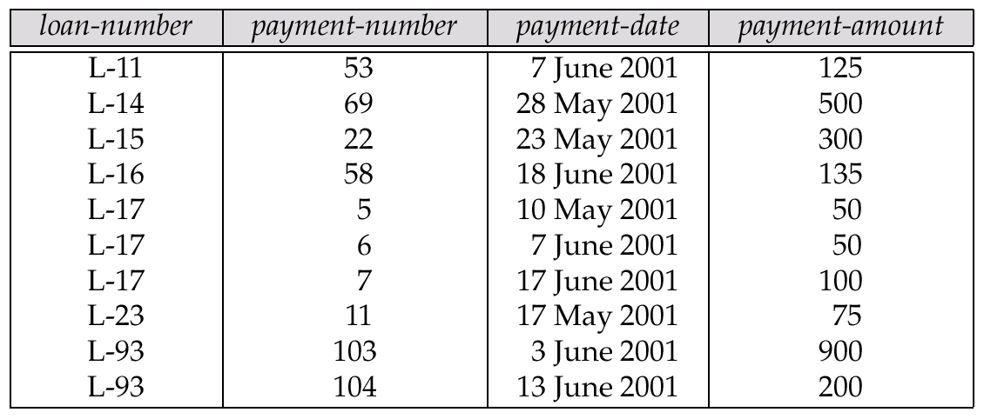
Representing Weak Entity Sets
A weak entity set becomes a table that includes a column for the primary key of the identifying strong entity set
E.g., 还款记录
Notes:
identifying ：识别

Slide 55
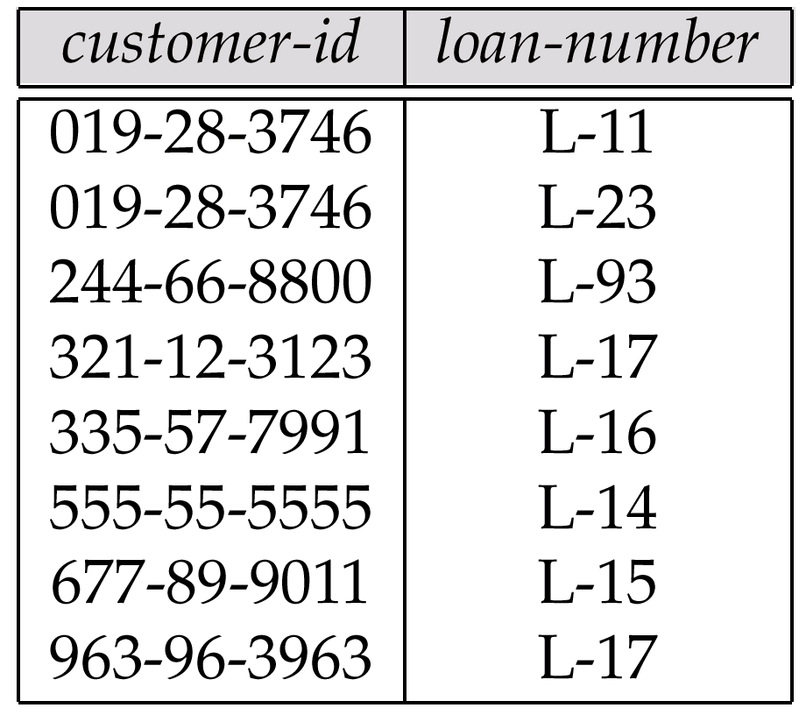
Representing Relationship Sets as Tables
Many-to-many relationship set
  Represented as a table with columns for the primary keys of the two participating entity sets, and any descriptive attributes of the relationship set.
  E.g., table for the relationship set borrower

Slide 56
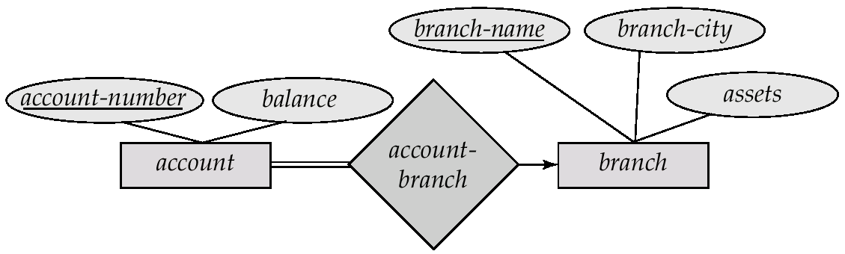
Representing Relationship Sets as Tables
Many-to-one and one-to-many relationship sets
  Can be represented by adding an extra attribute to the many side, containing the primary key of the one side
  E.g., instead of creating a table for relationship account-branch, add an attribute branch-name to the entity set account
many side
one side

Slide 57
Representing Relationship Sets as Tables
One-to-one relationship sets
  either side can be chosen to act as the “many” side

Slide 58
Representing Specialization as Tables
Method 1:
  Form a table for the higher level entity
  Form a table for each lower level entity set, include primary key of higher level entity set and local attributes
table table attributes
person name, street, city
customer name, credit-rating
employee name, salary
  Drawback: Querying information about entities, e.g., employee, requires accessing two tables
Notes:
credit-rating：信用评级

Slide 59
Representing Specialization as Tables (Cont.)
Method 2:
  Form a table for each entity set with all local and inherited attributes
table table attributes
person name, street, city
customer name, street, city, credit-rating
employee name, street, city, salary
  Drawback: street and city may be stored redundantly for persons who are both customers and employees

Slide 60
Banking Relational Schema
branch = (branch_name, branch_city, assets)
customer = (customer_id, customer_name, customer_street, customer_city)
loan = (loan_number, amount)
account = (account_number, balance)
employee = (employee_id, employee_name, telephone_number, start_date)
dependent_name = (employee_id, dname) (derived from a multivalued attribute)
account_branch = (account_number, branch_name)
loan_branch = (loan_number, branch_name)
borrower = (customer_id, loan_number)
depositor = (customer_id, account_number, access_date)
cust_banker = (customer_id, employee_id, type)
works_for = (worker_employee_id, manager_employee_id)
payment =(loan_number,payment_number, payment_date,payment_amount)
savings_account = (account_number, interest_rate)
checking_account = (account_number, overdraft_amount)

Slide 61
Outline
Overview of the Design Process
Entity-Relationship Model (实体联系模型)
Constraints
Entity-Relationship Diagrams (实体联系图)
Reduction to Relation Schemas
Summary

Slide 62
Database Design Phases
S1: Requirement analysis
  Data storage requirement
  Functional requirements analysis
    Describe the operations that will be performed on the data
S2: Conceptual design (E-R Model)
S3: Logical implementation
  Mapping from conceptual model to implementation model
  E.g., relational model, OO model
S4: Physical implementation
  Specify physical features of the database, e.g., buffer size, index…
Notes:
OO：面向对象

Slide 63
Symbols used in E-R Diagrams

Slide 64
Symbols used in E-R Diagrams (Cont.)

Slide 65
Design Tools
Freedgo Design
  https://www.freedgo.com/
Lucidchart
  https://www.lucidchart.com/pages/
Visual Paradigm
  https://www.visual-paradigm.com/cn/
Edrawmax
  https://www.edrawsoft.cn/

Slide 66
Summary of E-R Model
Conceptual design follows requirements analysis
  Yield a high-level description of data to be stored
E-R model is popular for conceptual design
  Constructs are expressive, close to the way people think about their applications
Basic constructs: entities, relationships, and attributes (of entities and relationships)
Some additional constructs: weak entities, ISA hierarchies
Note: There are many variations on E-R model

Slide 67
Summary of ER Model (Cont.)
Integrity constraints in E-R model
  Key constraints, participation constraints, and overlap/covering constraints for ISA hierarchies. Some foreign key constraints are also implicit in the definition of a relationship set
  Some constraints (notably, functional dependencies) cannot be expressed in the E-R model
  Constraints play an important role in determining the best database design for an enterprise

Slide 68
Summary of ER Model
E-R design is subjective
  There are often many ways to model a given scenario! Analyzing alternatives can be tricky, especially for a large enterprise. Common choices include:
    Entity vs. attribute, entity vs. relationship, binary or n-ary relationship, whether or not to use ISA hierarchies
Ensuring good database design
  The generated relational schema should be analyzed and refined further
  FD information and normalization techniques are especially useful (《数据库系统概念》第7章)
Notes:
FD :Functional Dependencies

Slide 69
课堂练习
书店管理应用包含三个实体集
  Bookstore: BSName, BSaddress, BSTel, BSManager
  Book: BookNo, BName, BPrice, Author, Publisher, PublishYear, Version
  Warehouse：WNo, WName, WAddress, Wadministrator
两个关系集
  Sale (Bookstore and Book): SaleDate and SaleQuantity
  Stock (Warehouse and Book)：InDate, InPrice, and StockQuantity
问题: 给出对应的E-R图和关系模式，并指出主码和外码

Slide 70
E-R图
BookNo
WName
BSaddress
BPrice
InDate
SaleDate
BSname
WNo
BName
Bookstore
Sale
Book
Stock
Warehouse
Author
Publisher
InPrice
Wadministrator
BSTel
SaleQuantity
BSManager
PublishYear
Version
StockQuantity
WAddress

Slide 71
关系模式
Relation schemas & primary keys
  Bookstore (BSName, BSaddress, BSTel, BSManager)
  Book (BookNo, BName, BPrice, Author, Publisher, PublishYear, Version)
  Warehouse (WNo, WName, WAddress, Wadministrator)
  Sale (BSName, BookNo, SaleDate, SaleQuantity)
  Stock (BookNo, WNo, InDate, InPrice, StockQuantity)
Foreign keys
  Sale references Bookstore and Book on BSName and BookNo, respectively
  Stock reference Warehouse and Book on WNo and BookNo, respectively

Slide 72
End of Chapter 6

